Slide 1
UML Diagrams
of
DONORS CHOOSE

Slide 2
Group Members
180041208
Fida Kamal
180041214
Fariha Fairoz Nohan
180041229
Alvi Aveen Khan
‹#›/7

Slide 3
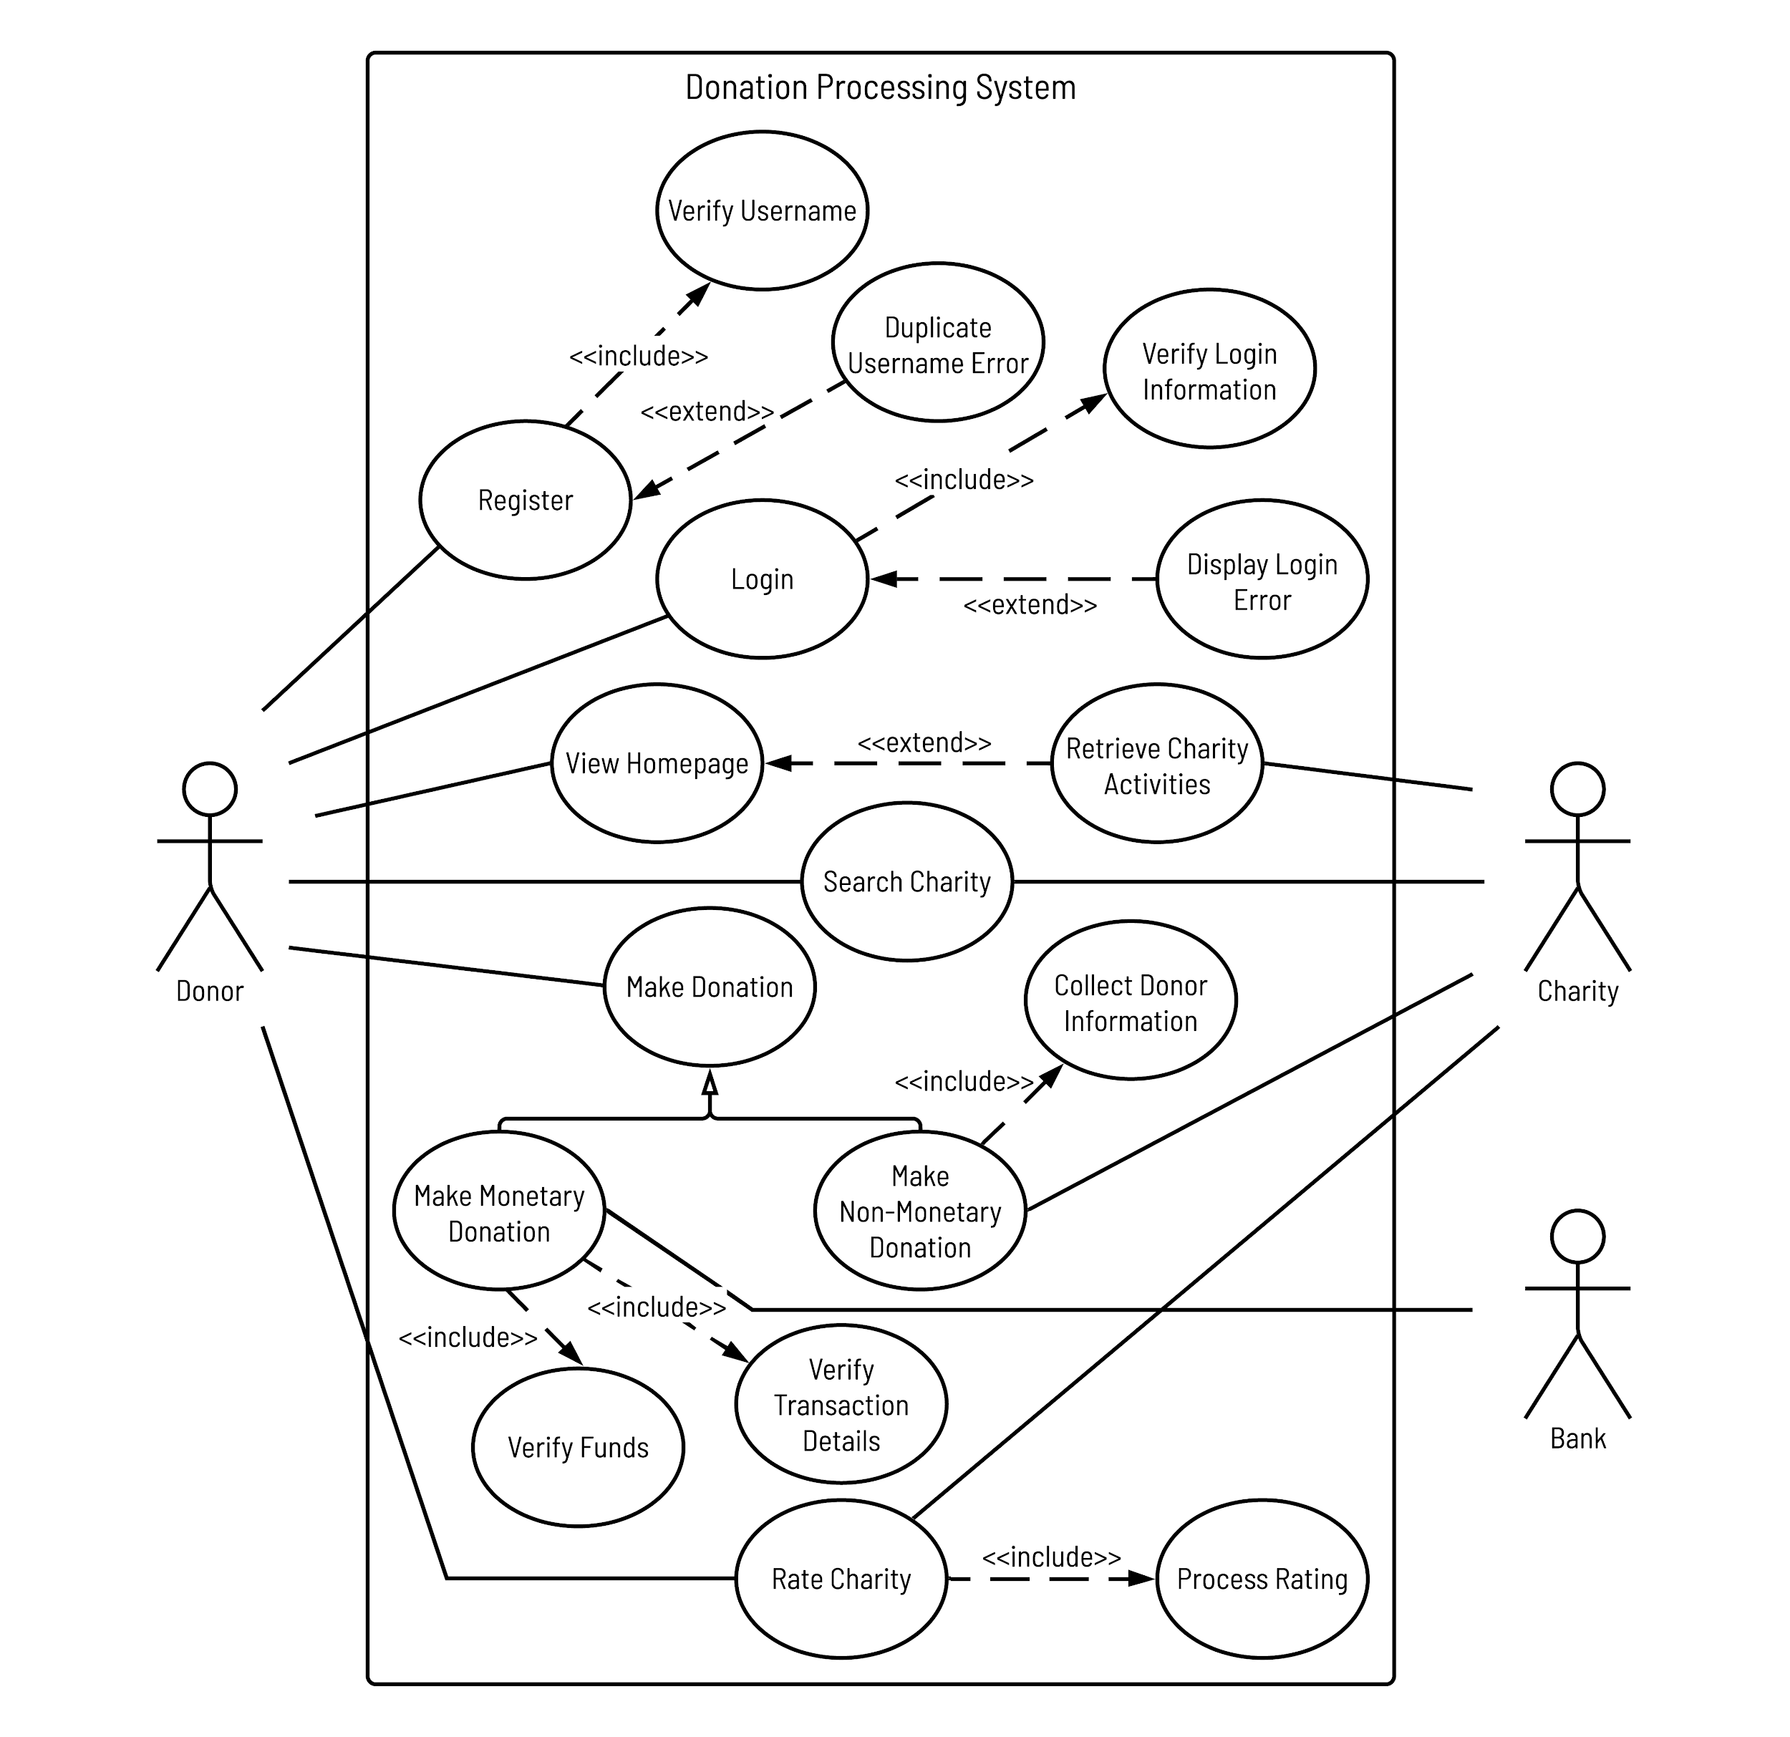
Use Case Diagram
‹#›/7

Slide 4
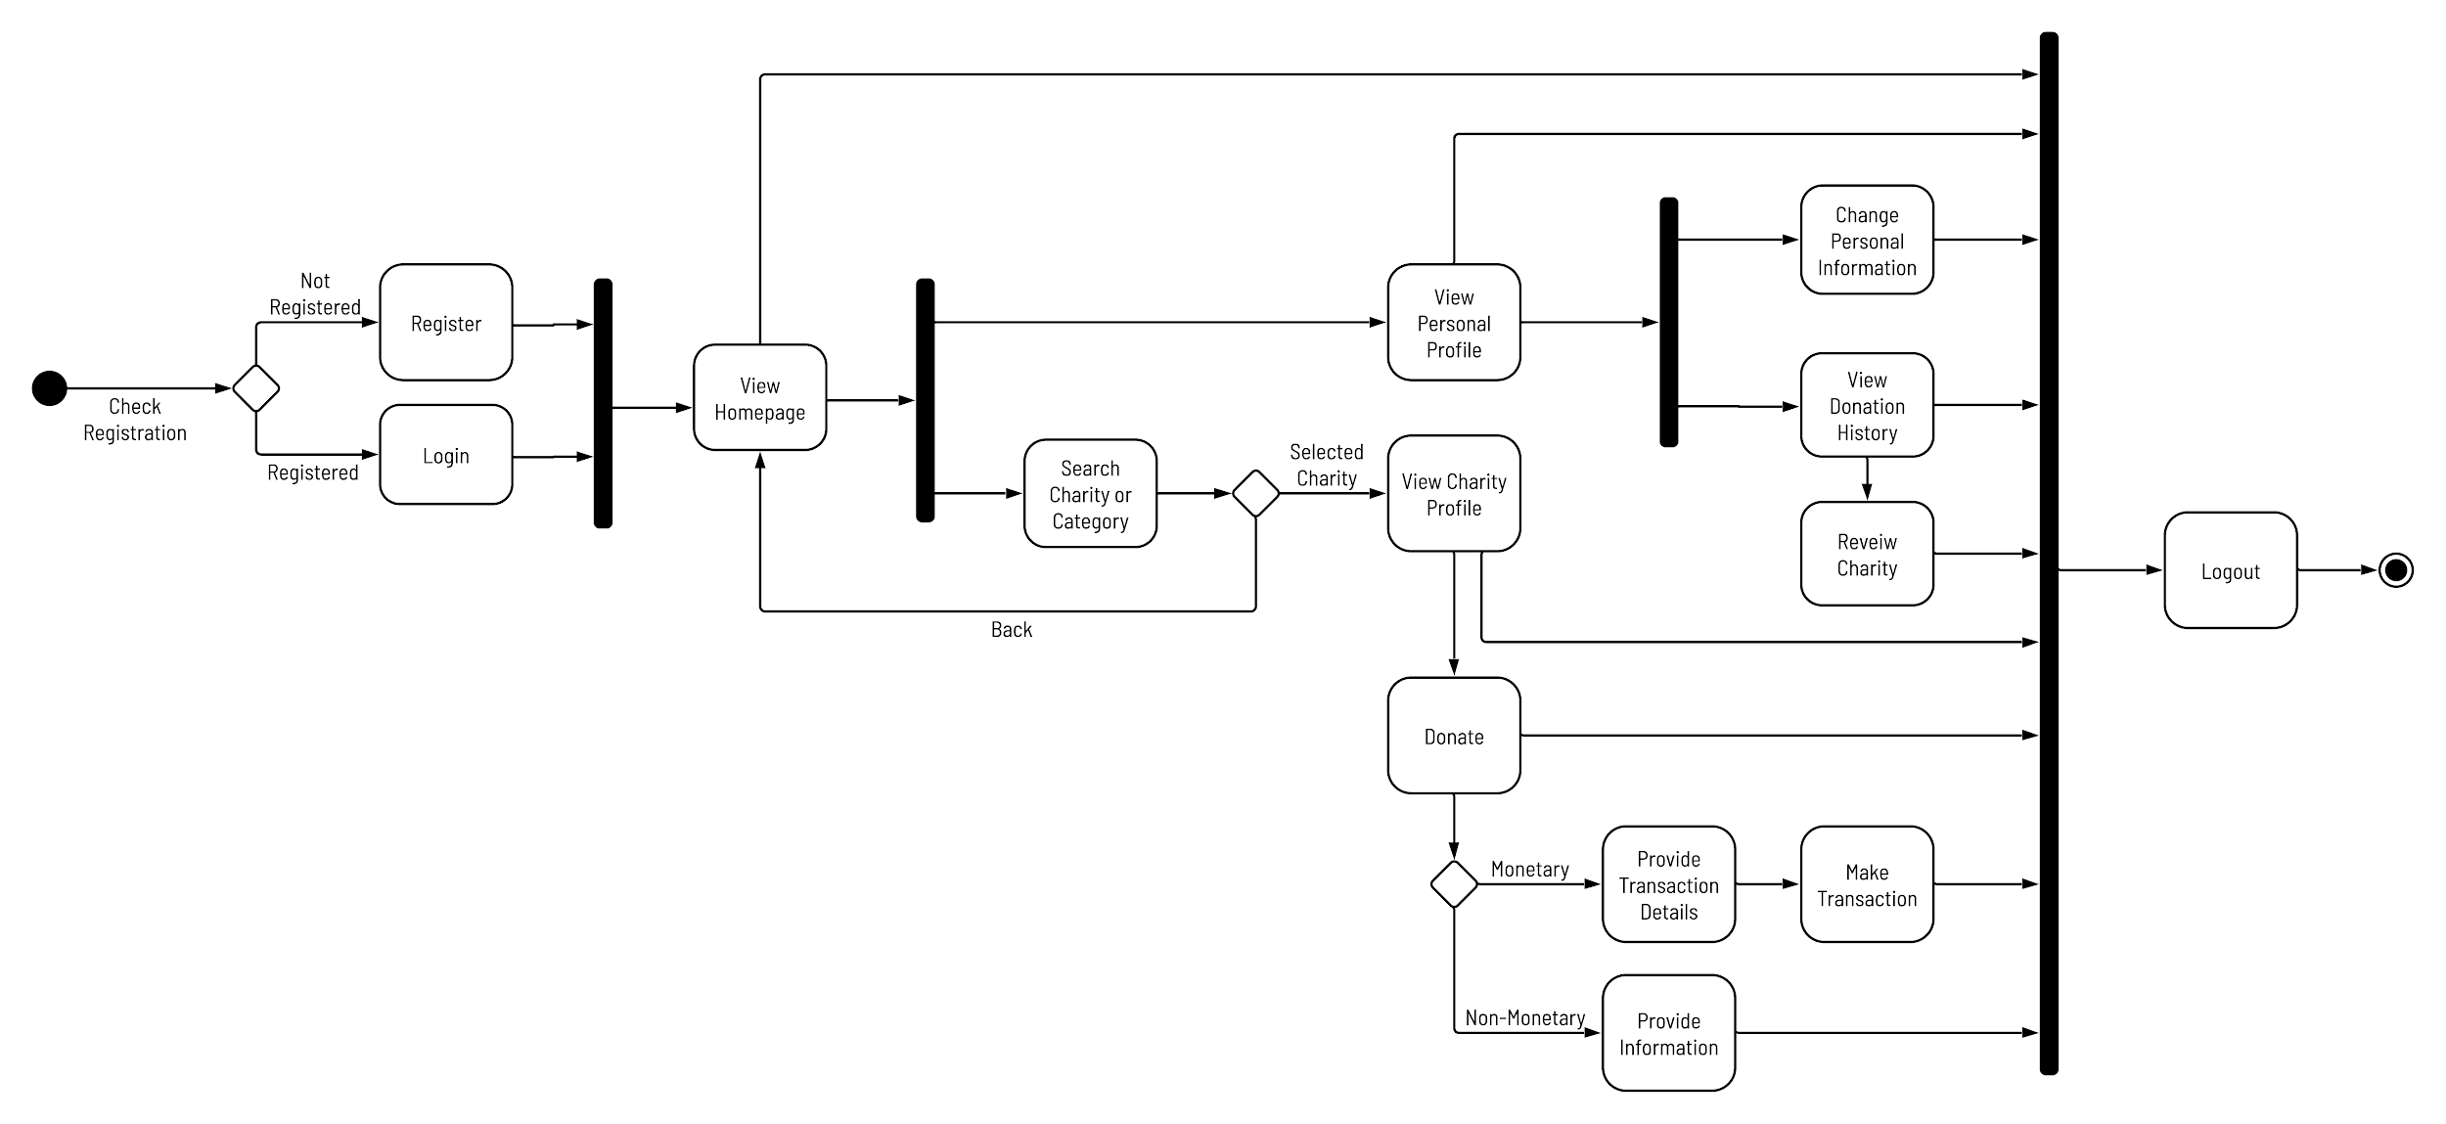
Activity Diagram
‹#›/7

Slide 5
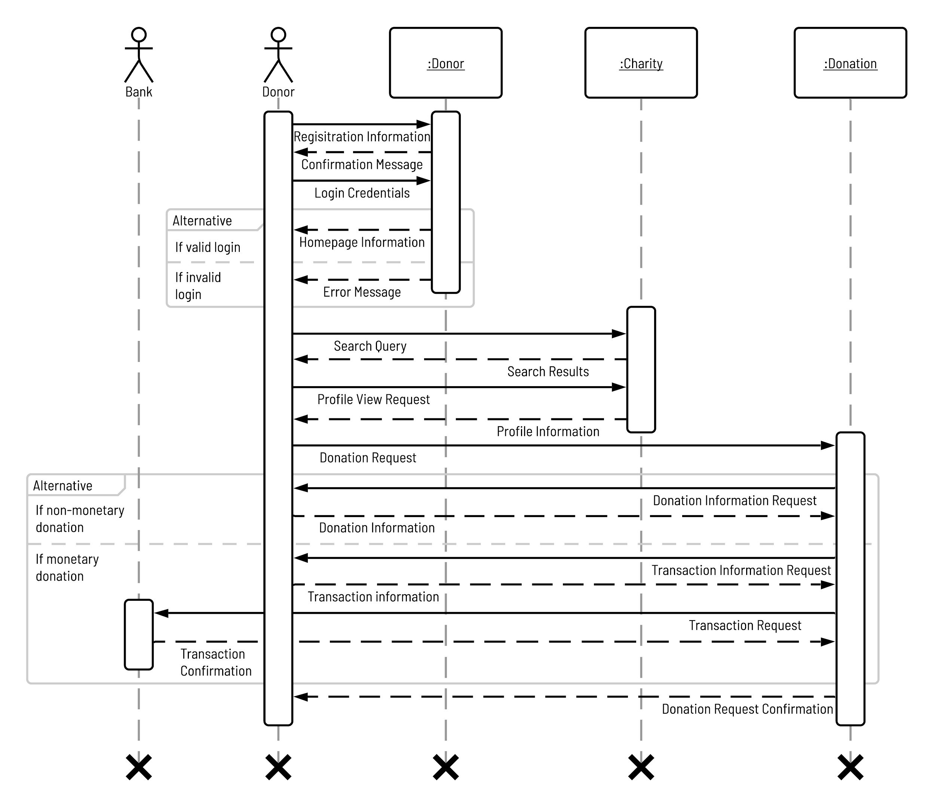
Sequence
Diagram
‹#›/7

Slide 6
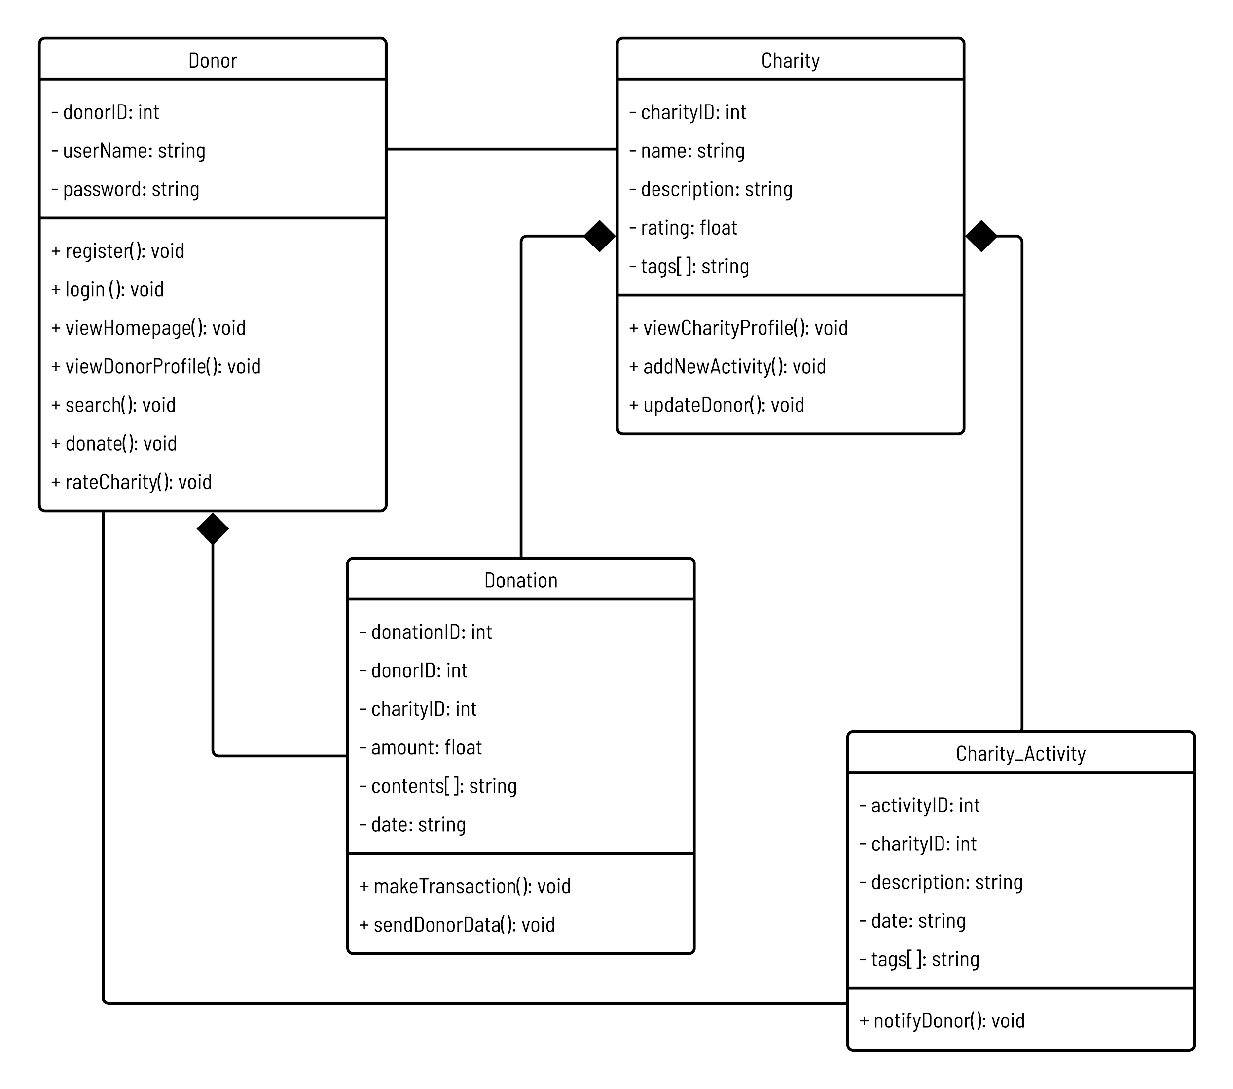
Class Diagram
‹#›/7

Slide 7
THANK YOU!
‹#›/7

